Slide 1
Intro to Radar Principles and Dual-Pol Parameters

Slide 2
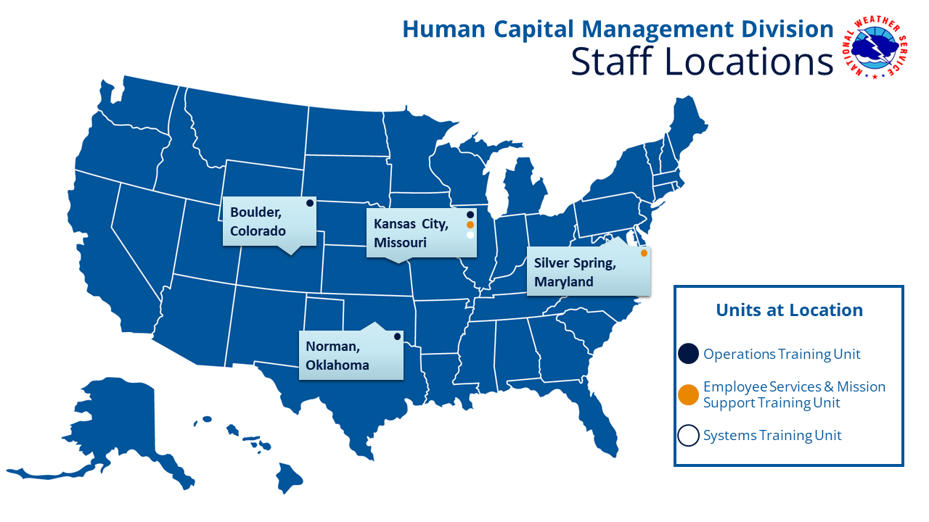
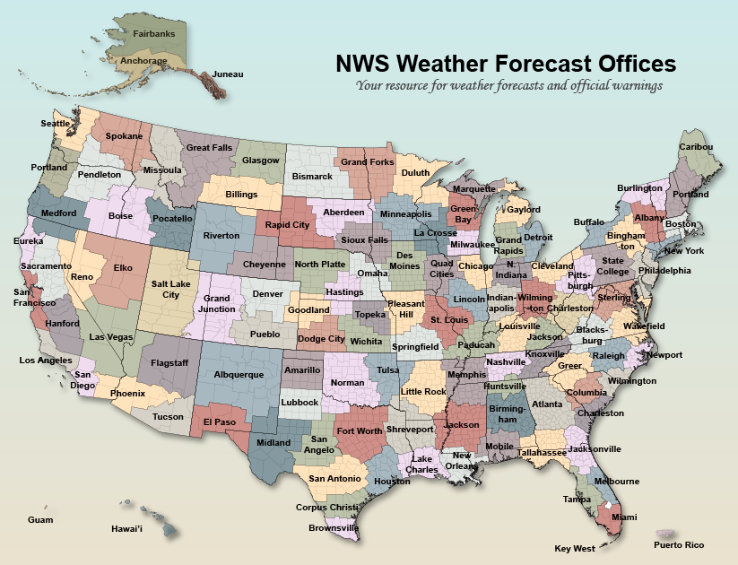
Why Us (OTU Feds & CIWRO)?
Operations Training Unit (formerly Warning Decision Training Division) teaches weather radar theory & applications to NWS forecasters for use in warning operations

Slide 3
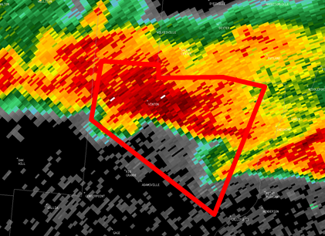
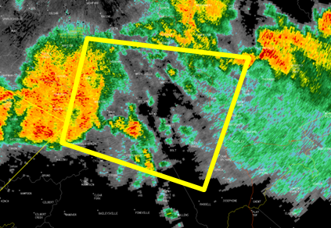
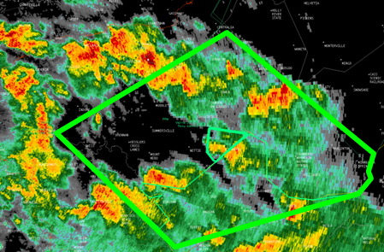
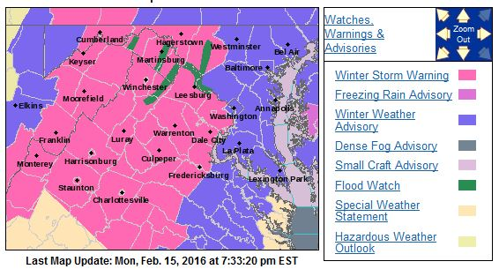
We Train on Warning Decision Making & Other Operational Tasks
Tornado
Severe Thunderstorm
Flash Flood
Job-centered
Time-sensitive tasks
Evidence-based
Focus on service to the public
Winter

Slide 4
Goals for Today
Part 1: Radar basics related to severe thunderstorms
Part 2: Radar analysis using Dual-Pol
Part 3: What can go wrong?

Slide 5
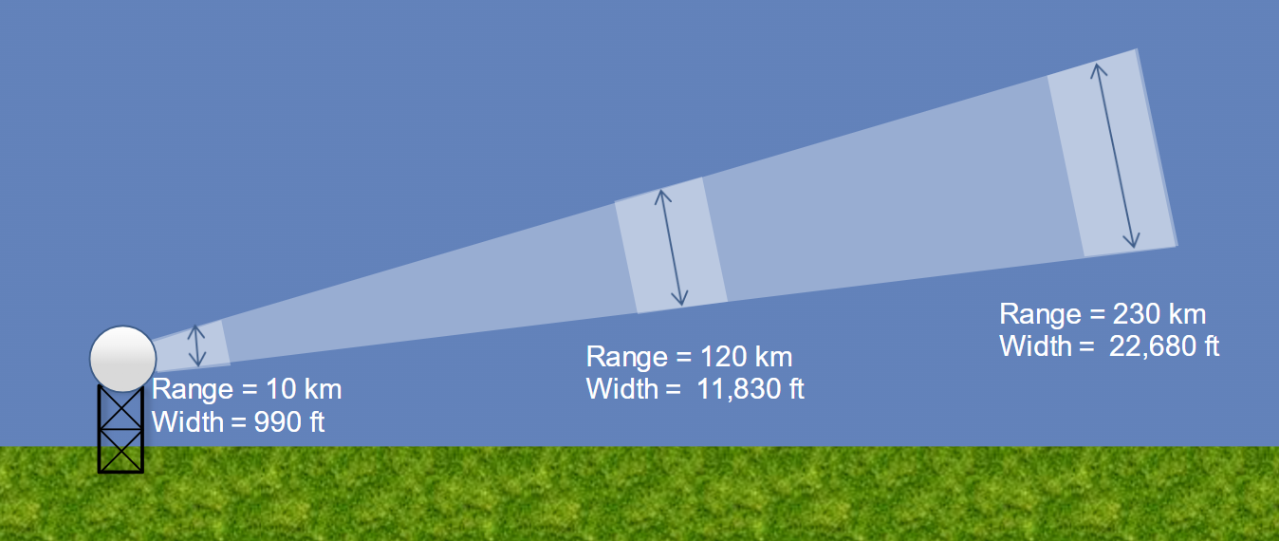
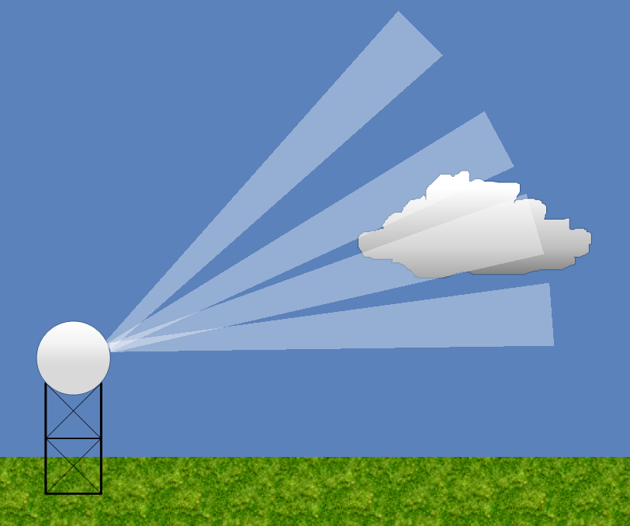
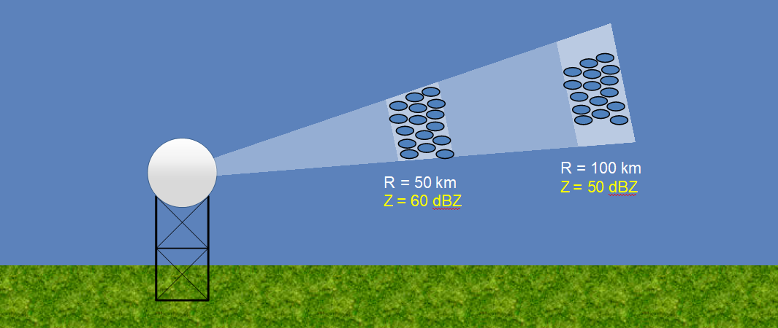
Why Range to Target Matters
Target range impacts:
Pulse/Beam Size
Altitude Sampled
Beam Filling

Slide 6
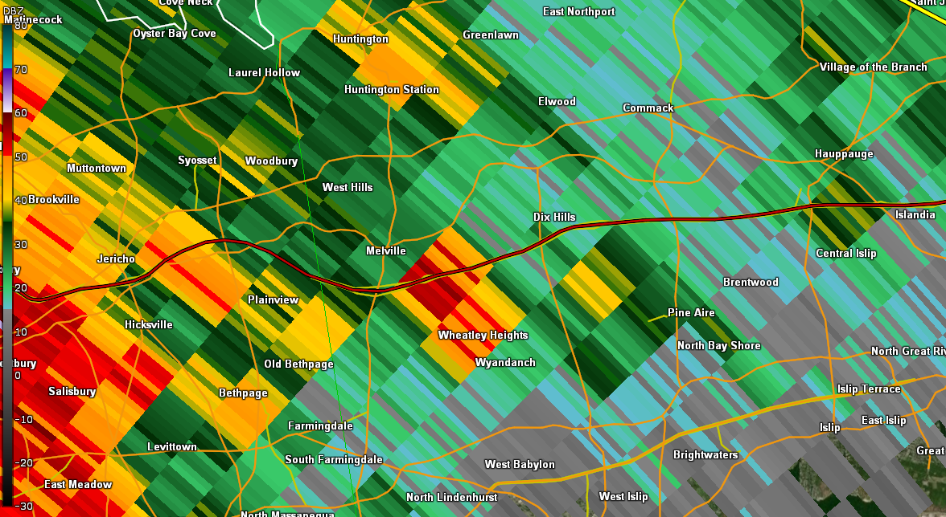
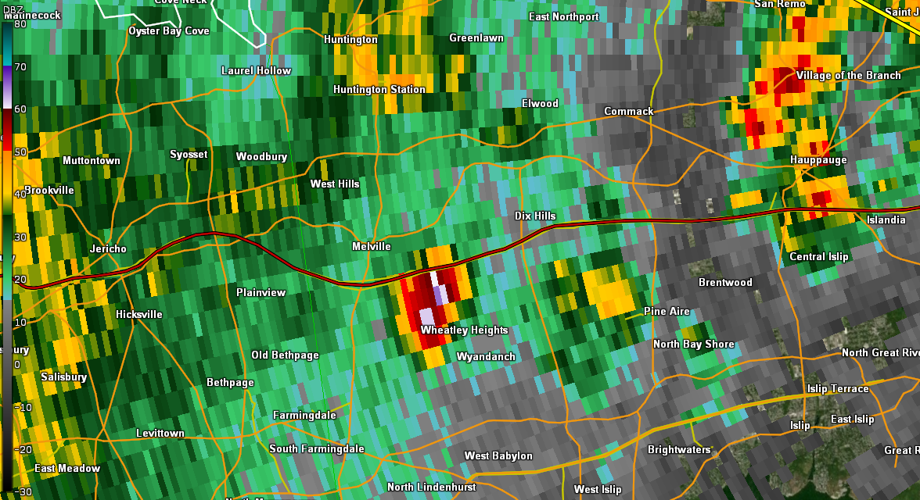
Example of How Target Range to Radar Impacts Appearance
Same storm, same time, same approximate height, but different ranges
Storm on left is farther, on lower tilt (2.4°):
Resolution poorer
Features smoothed out
Storm on right is closer, on higher tilt (8.0°):
Resolution finer
More detail apparent
2310 Z
Range: ~ 68 nm
Altitude: ~ 21 kft
2310 Z
Range: ~ 25 nm
Altitude: ~ 21 kft

Slide 7
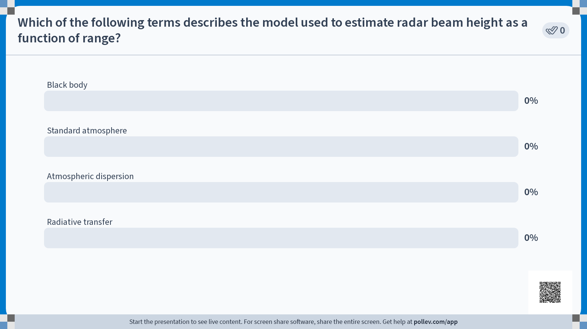

Slide 8
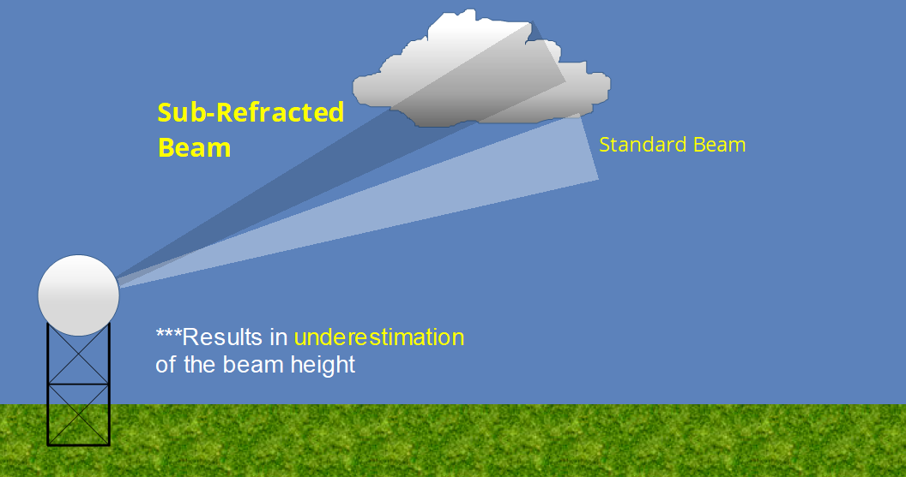
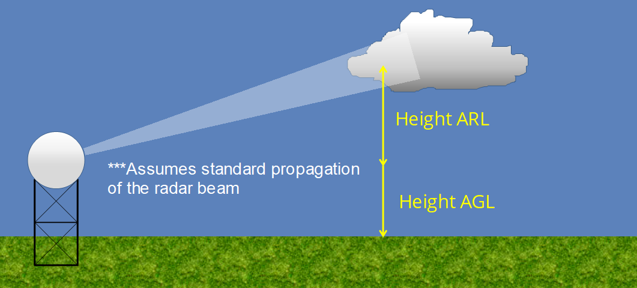
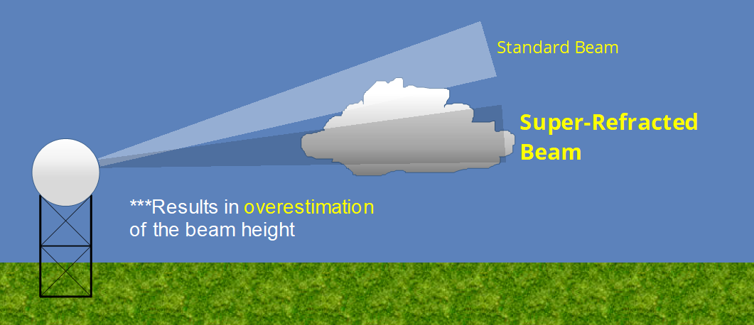
Radar Sampling Height, The Standard Atmosphere, and Uncertainty
Estimated beam heights based on standard atmosphere assumption:
The problem: The atmosphere is rarely like “the standard”
Standard Atmosphere
Strong lapse rates: Sub-refraction
Weak lapse rates/inversions: Super-refraction

Slide 9
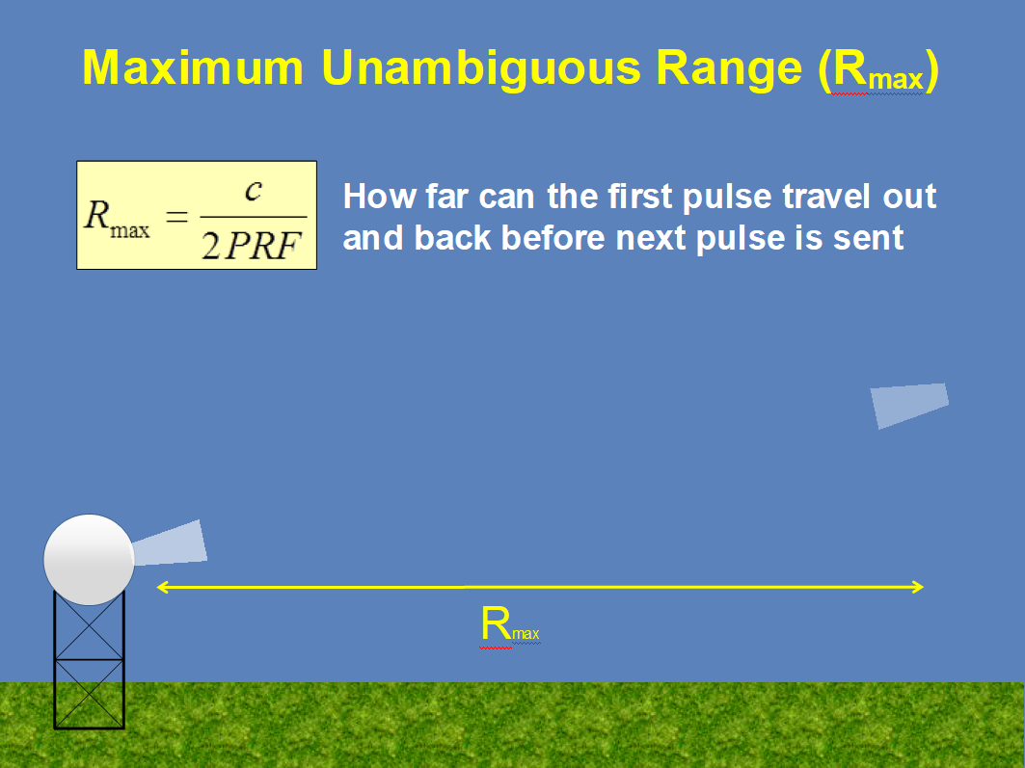

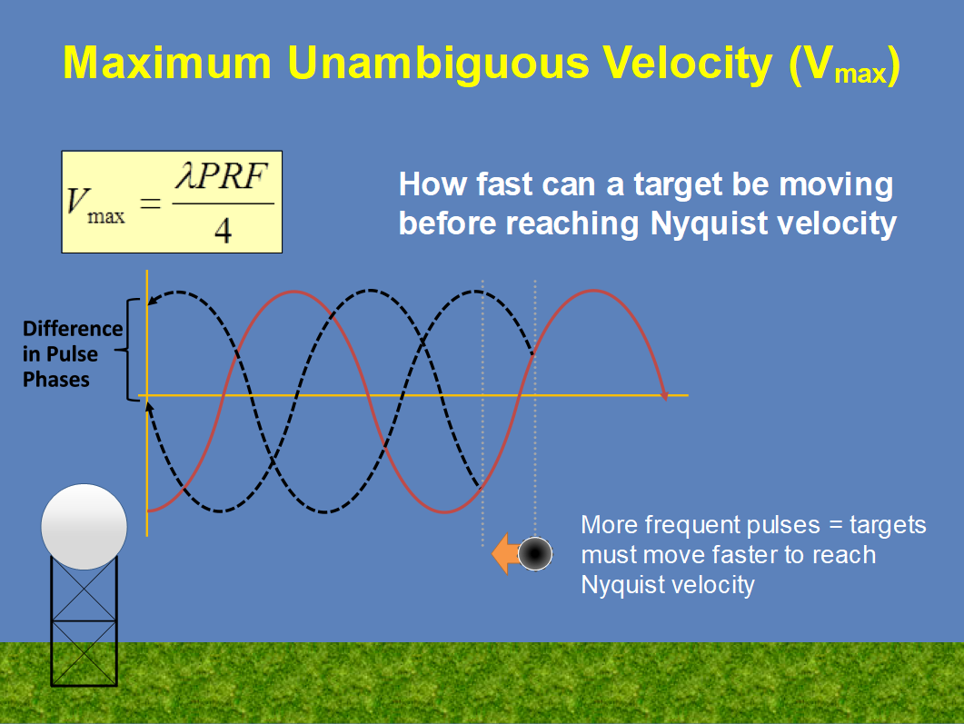
The Doppler Dilemma: Mitigation Takes Time!
Radar range and velocity determination are inversely related to each other
The WSR-88D uses several techniques to mitigate this issue
Unfortunately, these techniques result in longer data collection times

Slide 10

Why Mitigate the Doppler Dilemma? Well, Range Folding

Slide 11
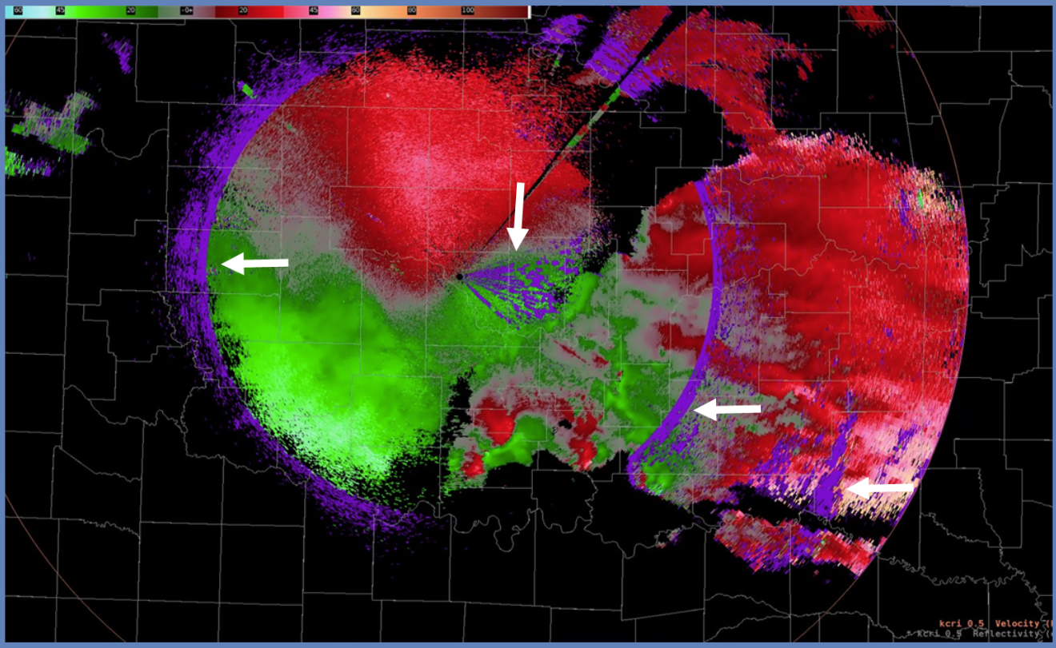
Range Folding Example

Slide 12
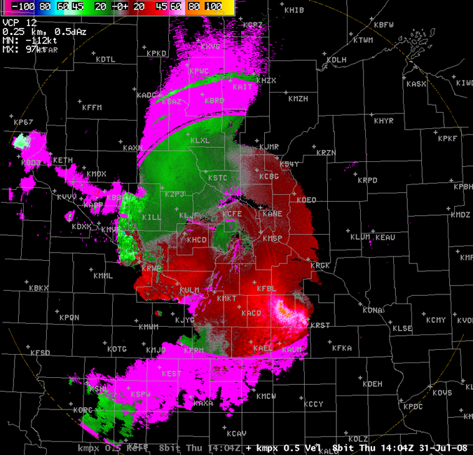
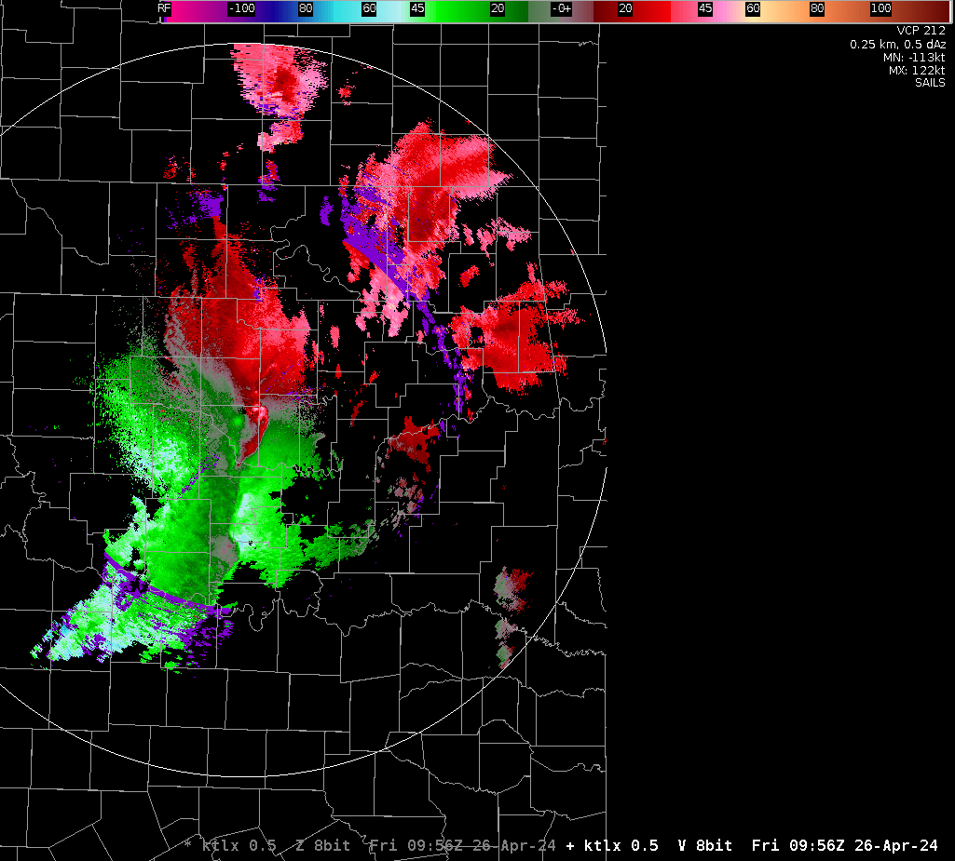
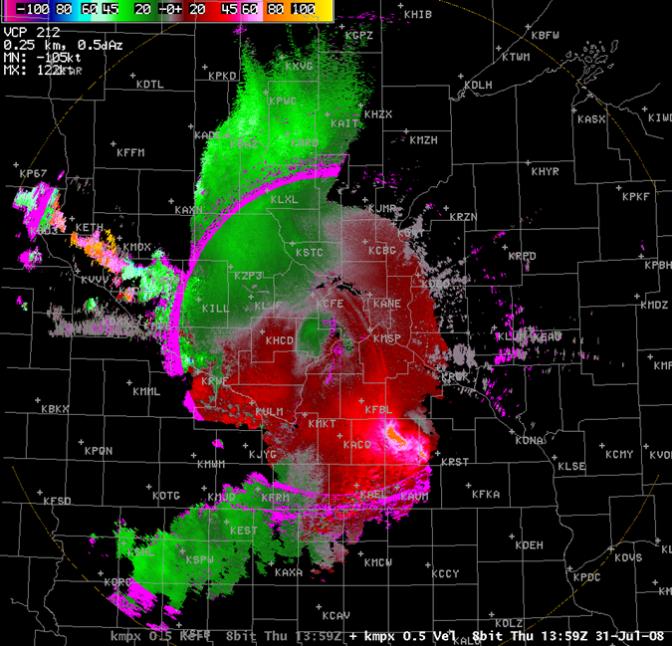
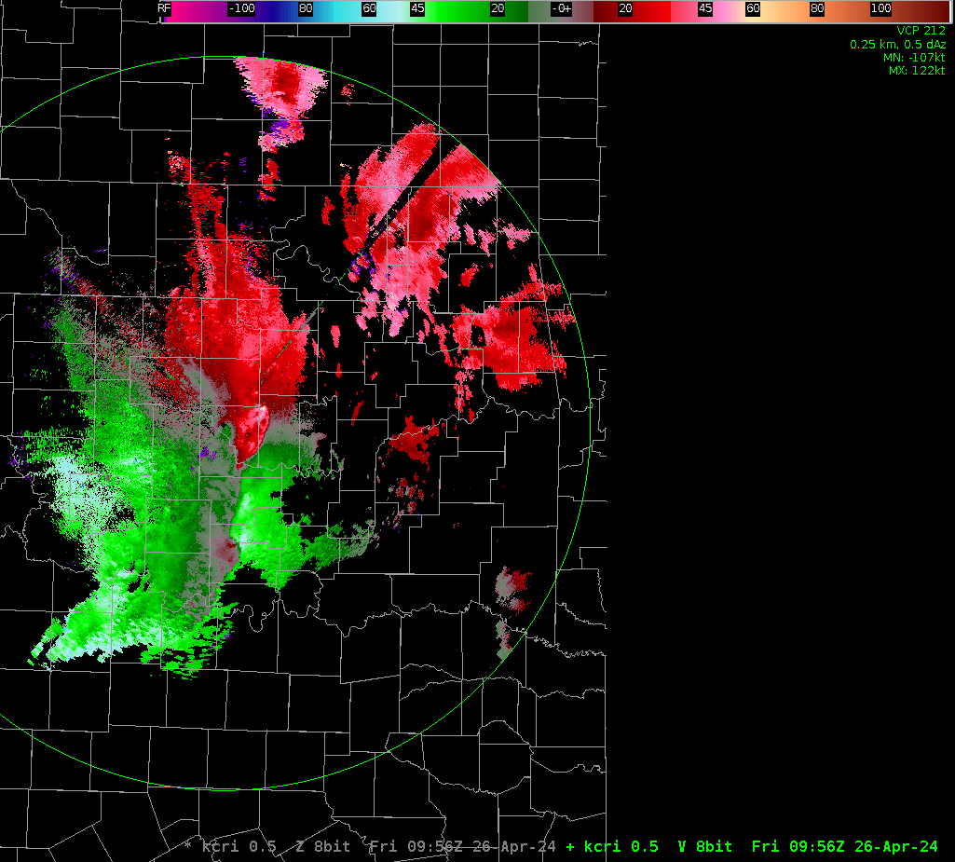
Doppler Dilemma Mitigation Strategies & Their Tradeoffs
Original
Sachidanada-Zrnic 2 (SZ-2) often can recover velocity data from multiple trips of overlaid echoes, reducing RF
Multiple PRF Dealiasing Algorithm uses multiple velocity scans at different PRFs to recover velocity data
While both techniques work well, they do add a significant amount of time to volume scans
SZ-2
SZ-2
MPDA

Slide 13


Slide 14
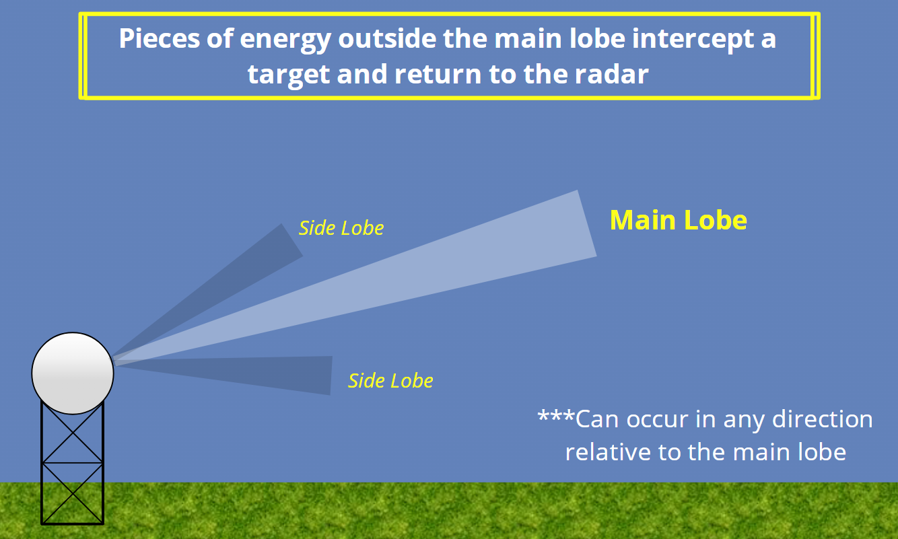
What Are Side Lobes & Why Are They Important?
View along
radial*
Main lobe
Side lobes
Relative energy
in each lobe*
*not to scale

Slide 15
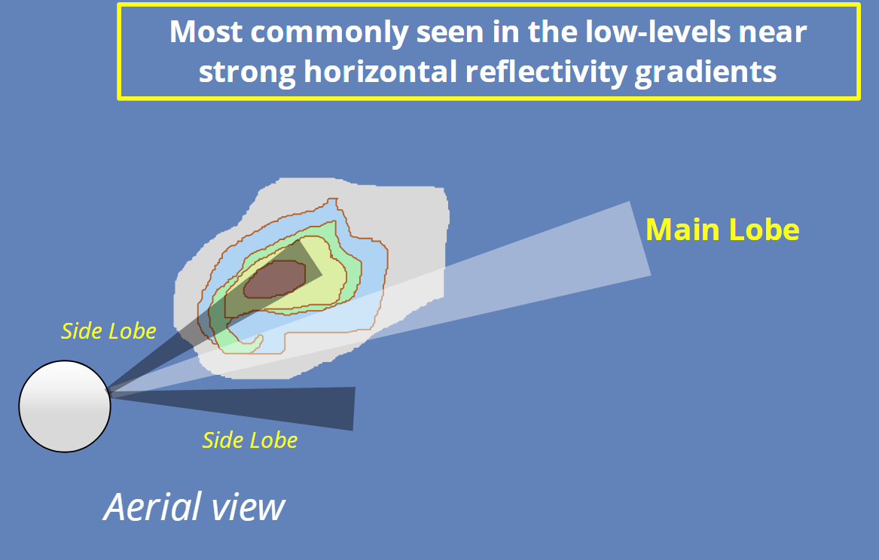
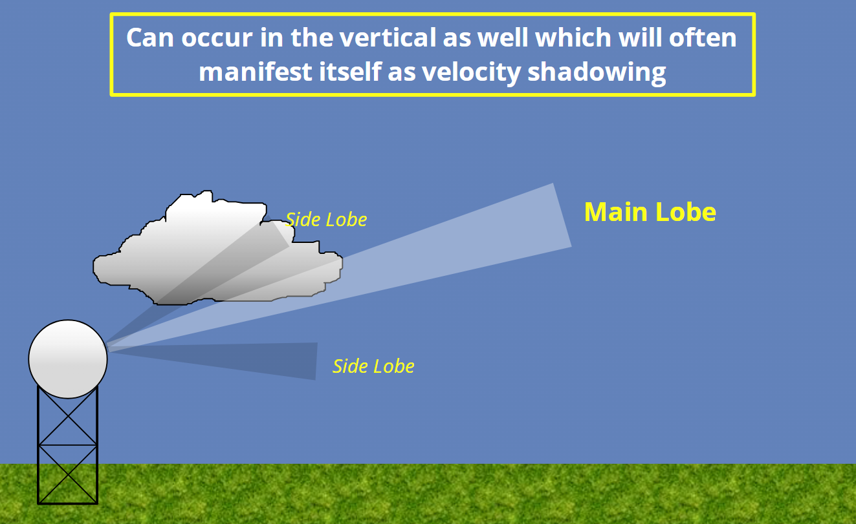
Side Lobe Contamination: When Energy from Side Lobes Is Significant
Horizontal Contamination
Elevation-Based Contamination

Slide 16
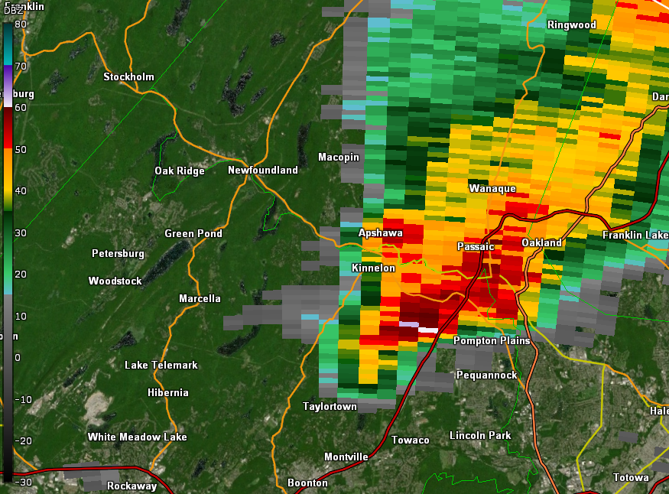
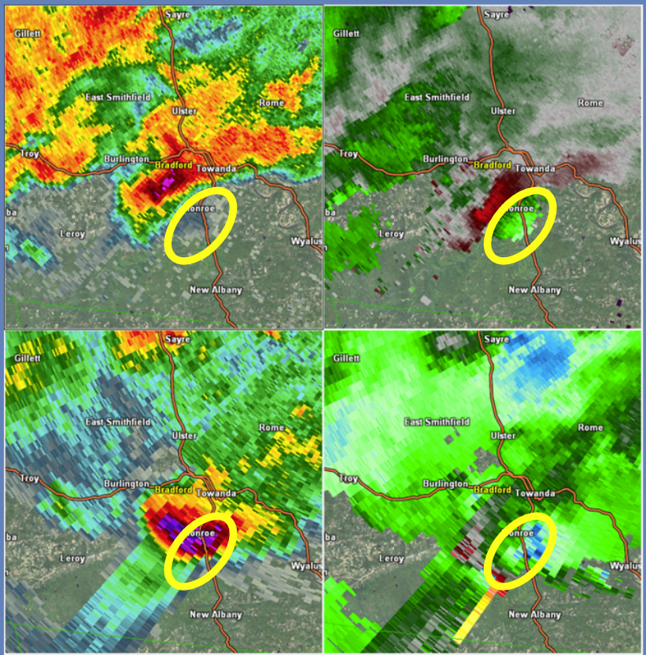
Side Lobe Contamination Examples
Horizontal
Elevation-Based

Slide 17
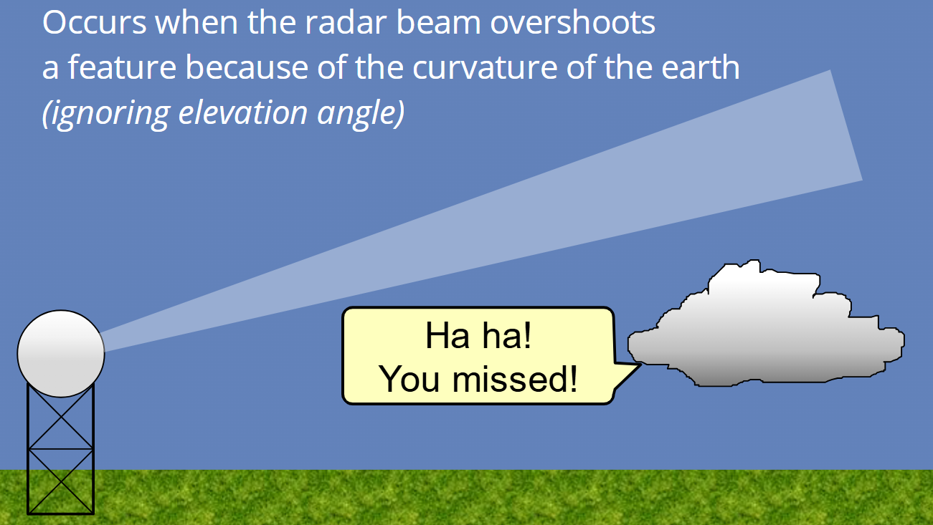
What’s Happening Below the Lowest Beam?

Slide 18
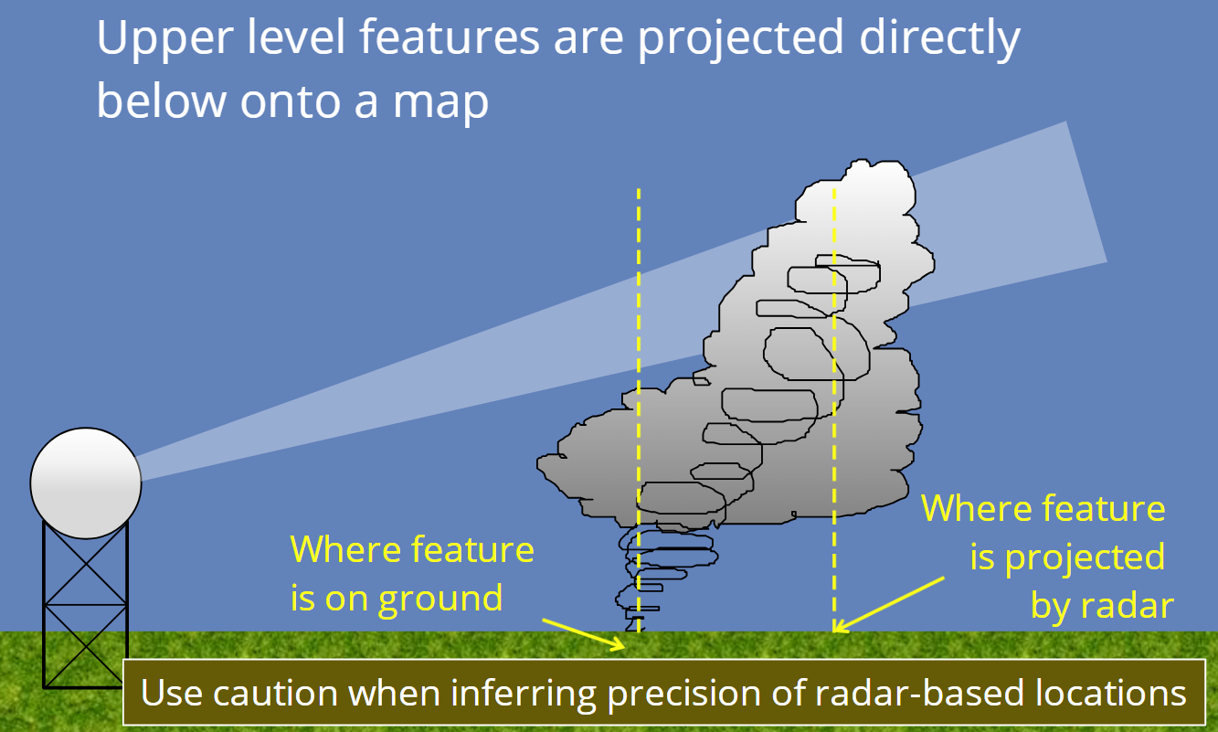
The Radar Locations Errors
Notes:
Radar sees mid-level meso at the right-hand dashed line. In reality, the tornado threat is at the left dashed line.

Slide 19
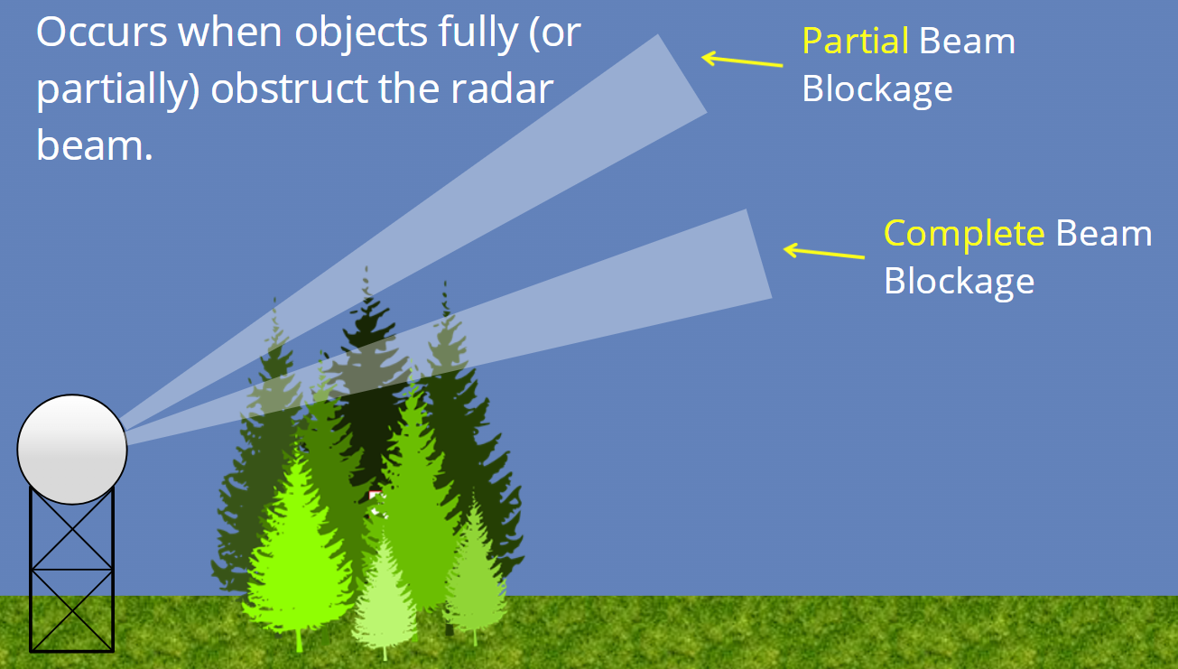
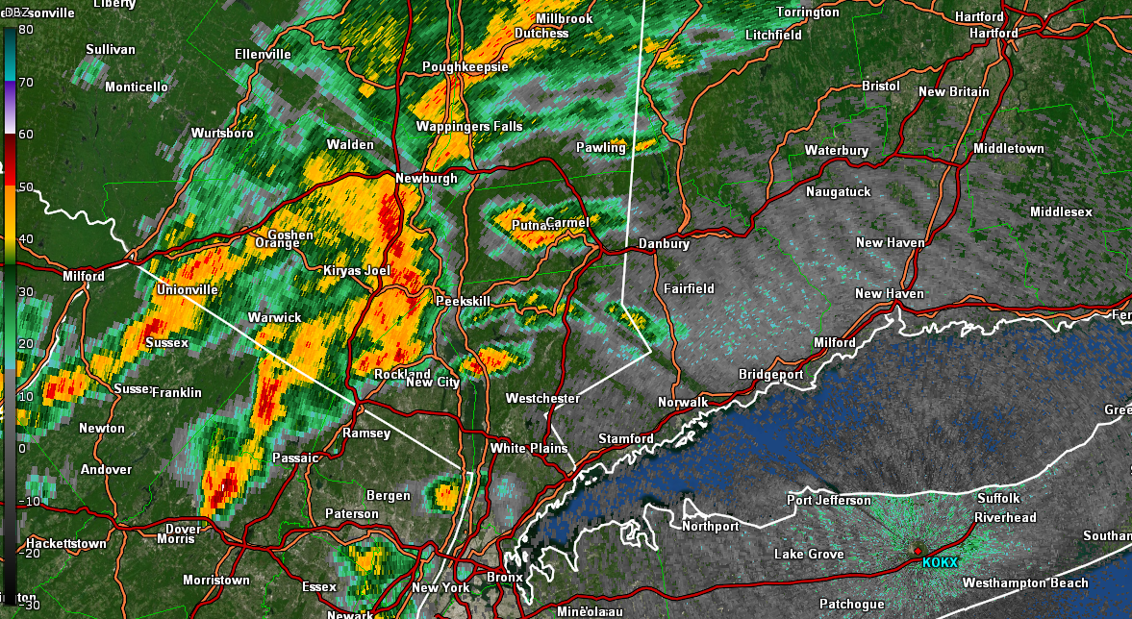
Beam Blockage

Slide 20
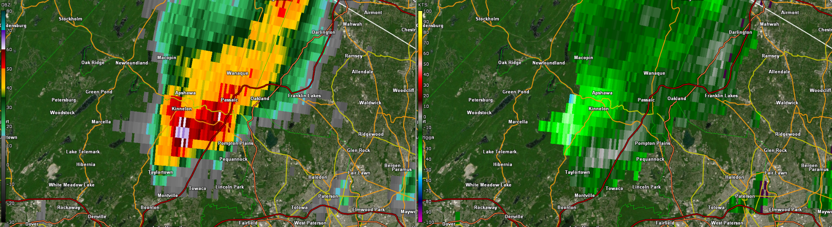
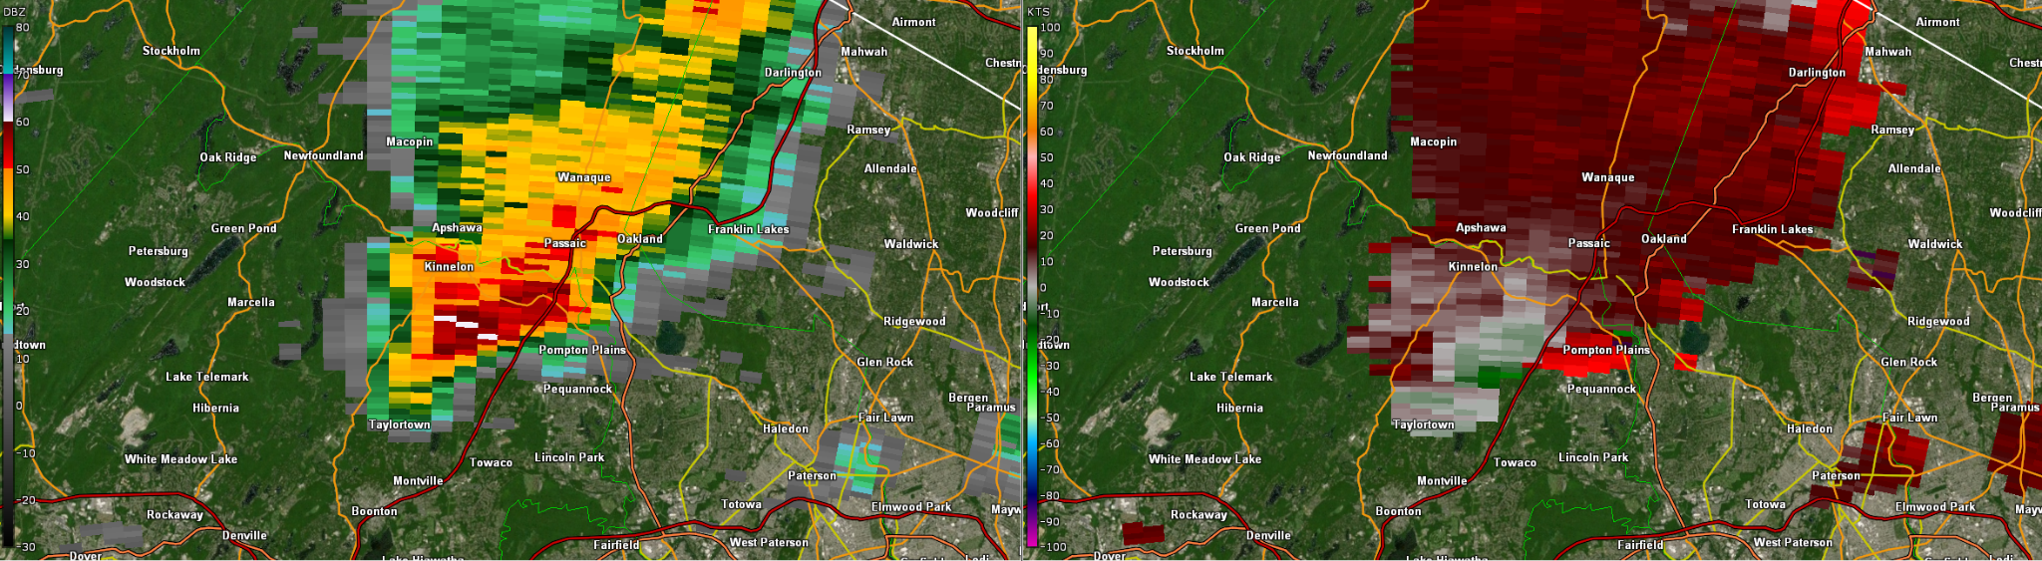
Viewing Angle Matters
Radar East
Same storm, but
different radars
Radar South

Slide 21
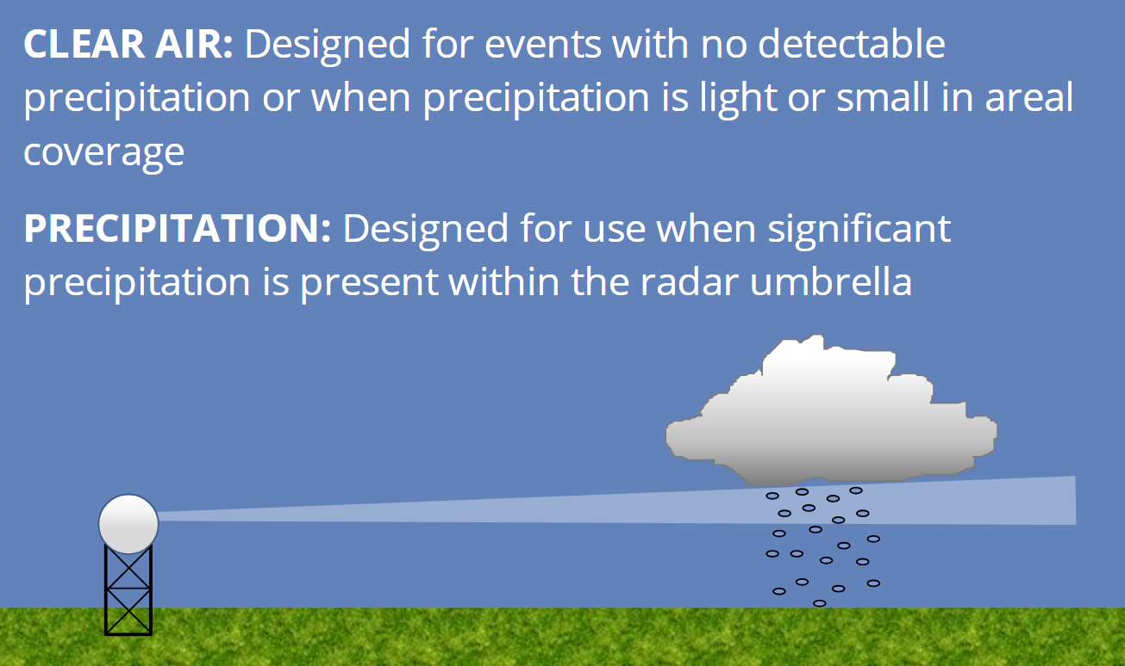
Operational Modes

Slide 22
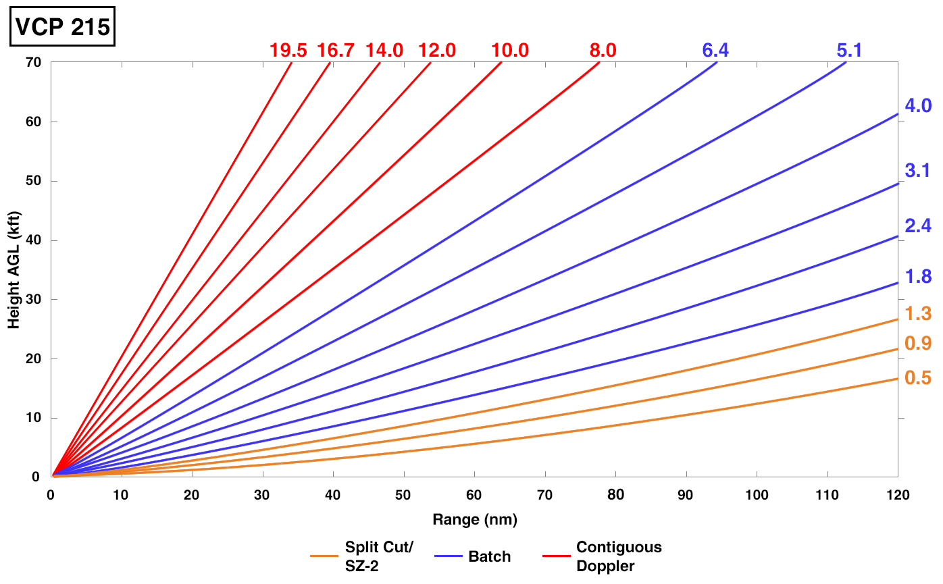
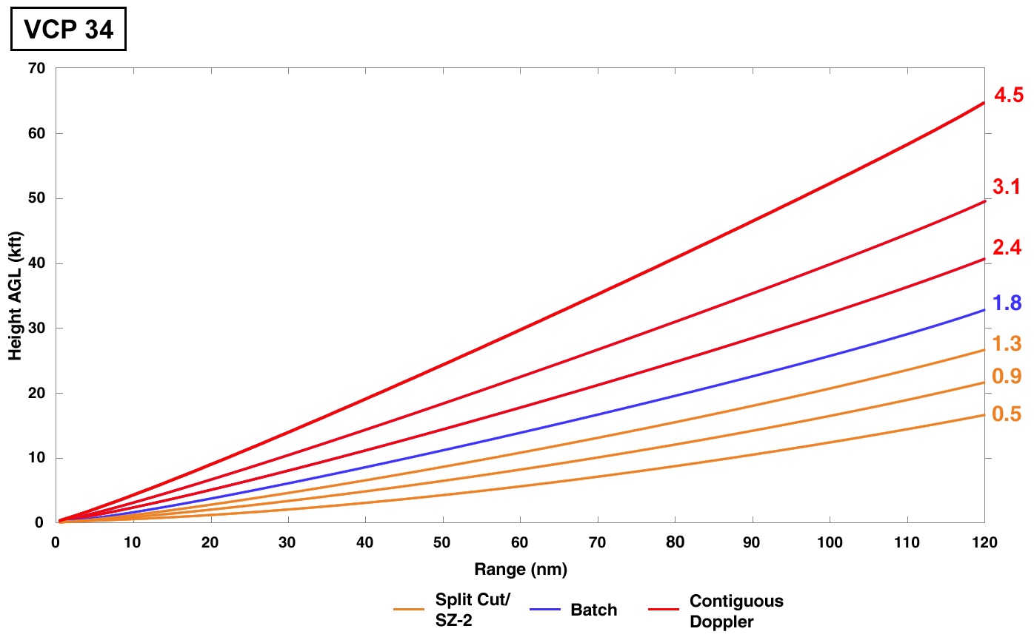
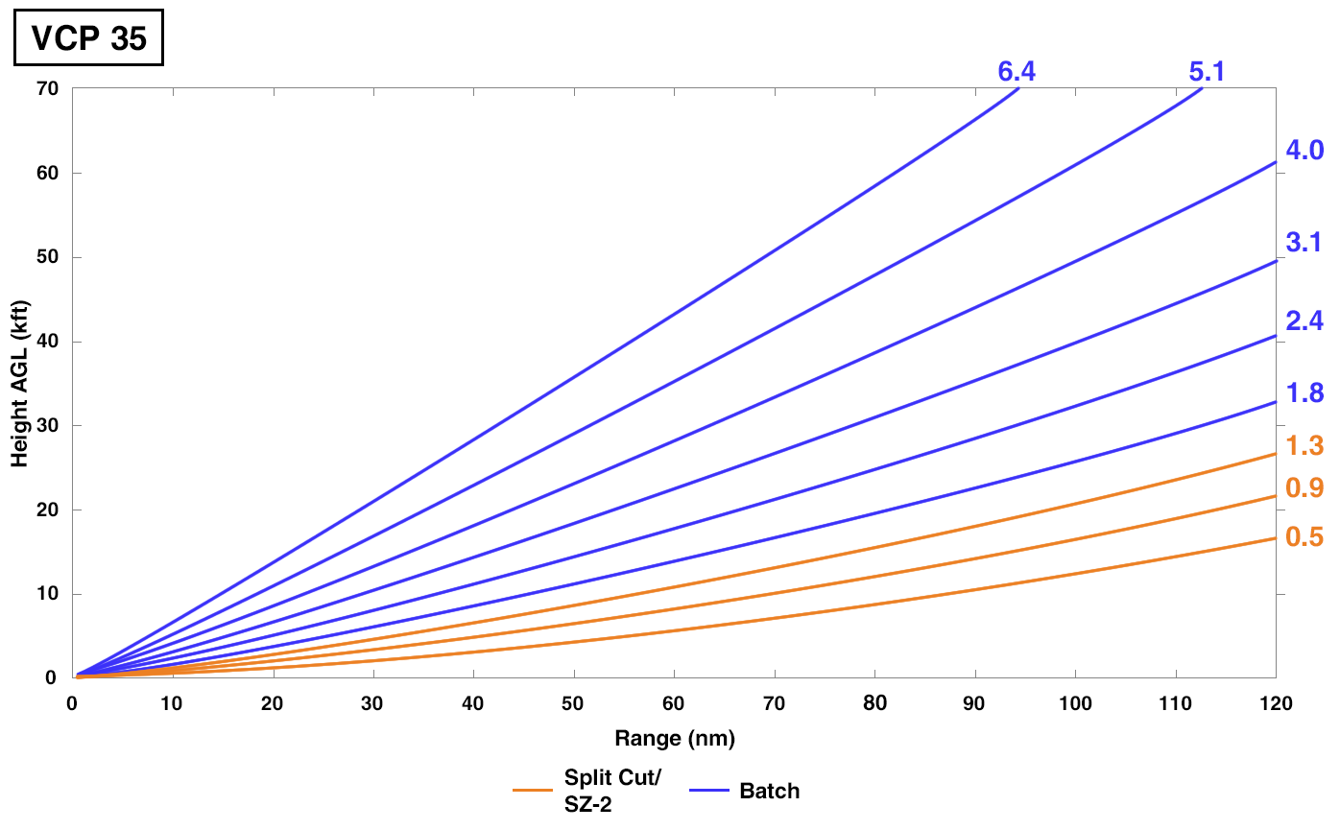
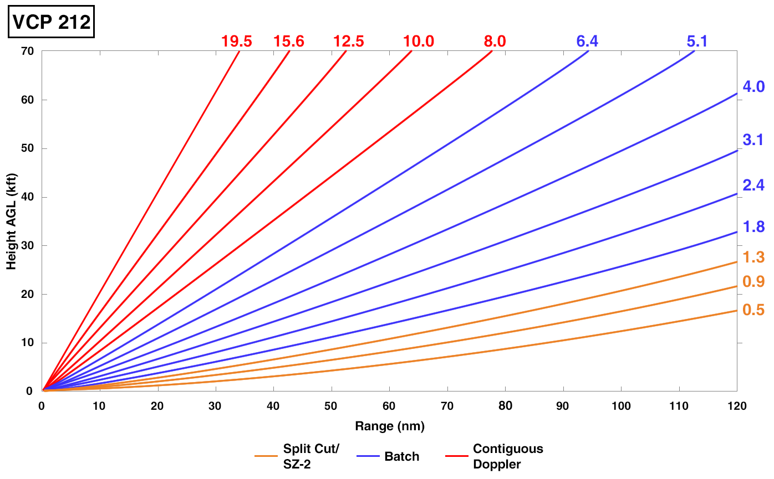
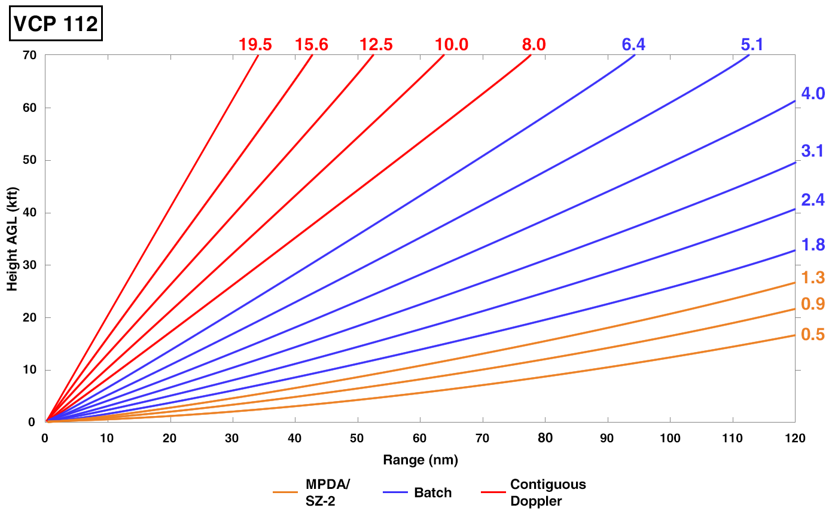
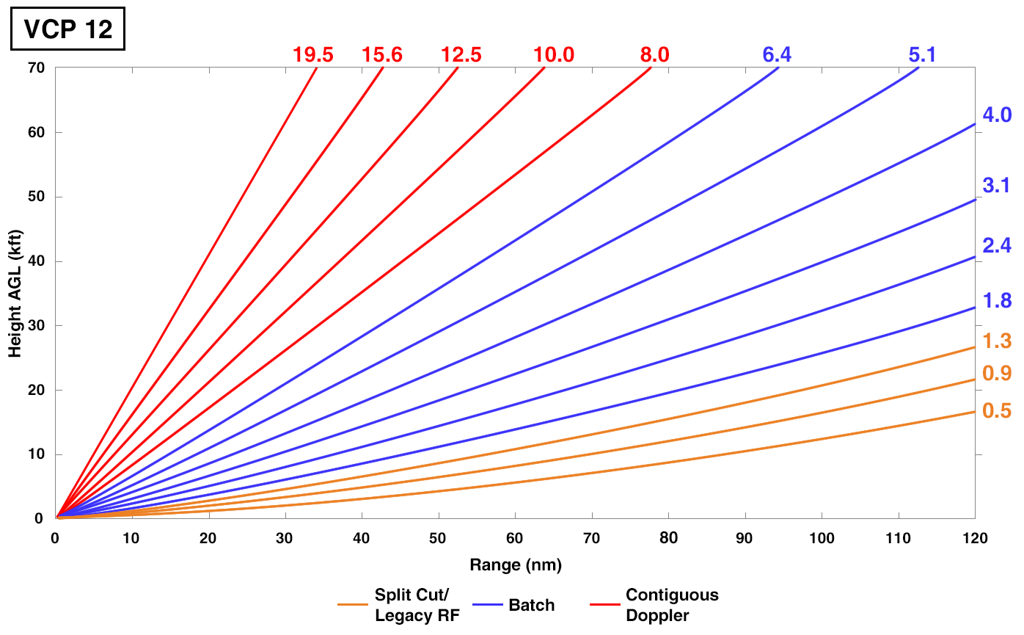
Radar Follows a Pre-Defined Scanning Strategy
Clear Air:
Precipitation:

Slide 23
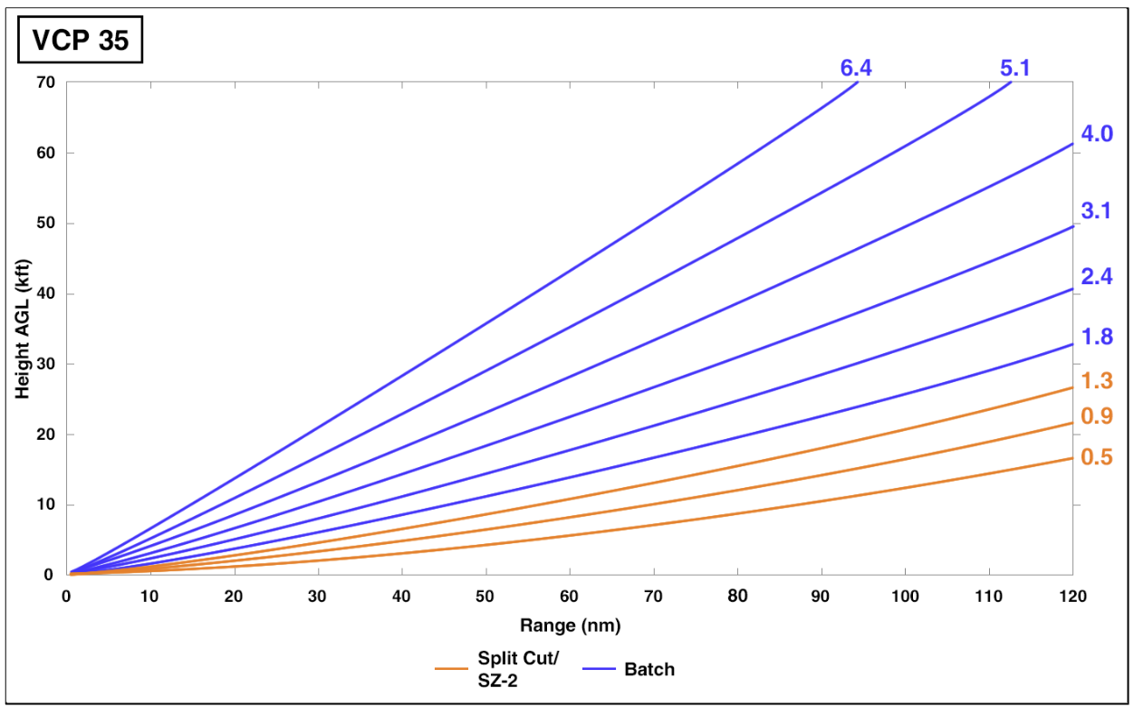
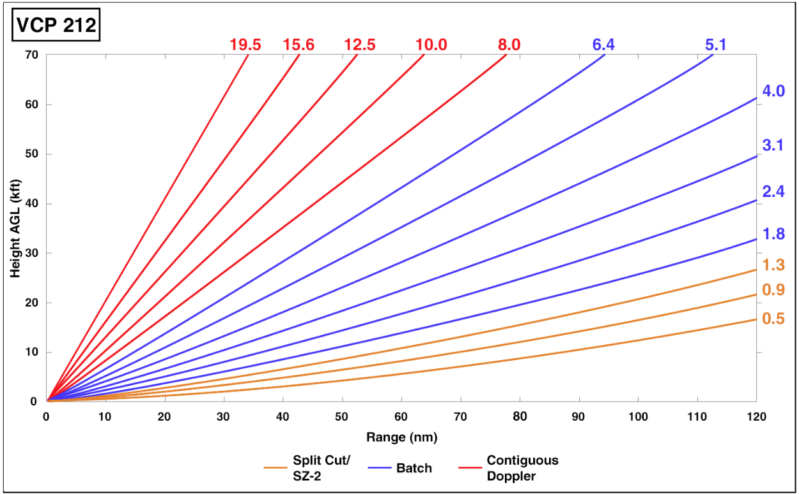
How High Up In the Atmosphere Is the Radar Sampling?
Depends on the VCP and the dynamic scanning settings (i.e., AVSET)!
Currently, amost every WSR-88D has AVSET enable all of the time
Notes:
Note in case it comes up: Depth of scanning strategy depends on VCP and is independent of standard atmosphere issue mentioned on previous slide. AVSET is another aspect of this topic, but it is dynamic and related to coverage of echoes. If it comes up, almost all NWS sites have AVSET enabled when in precipitation mode (which is the only time it can be enabled)

Slide 24
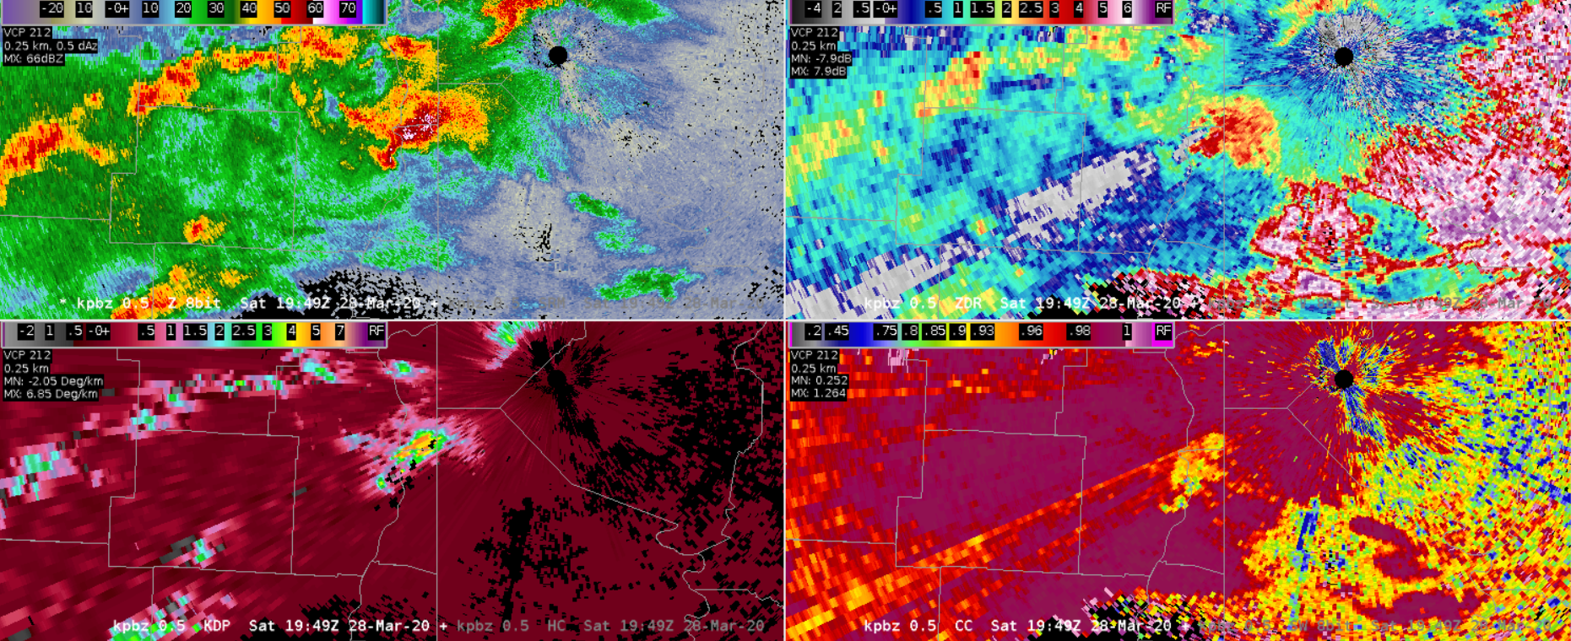
Dual-Pol Review
Differential Reflectivity (ZDR):
Good for assessing size and/or shape of targets!
Specific Differential Phase (KDP):
Good for assessing liquid water content!
Correlation Coefficient (CC):
Good for identifying meteorological vs. non-meteorological targets!

Slide 25
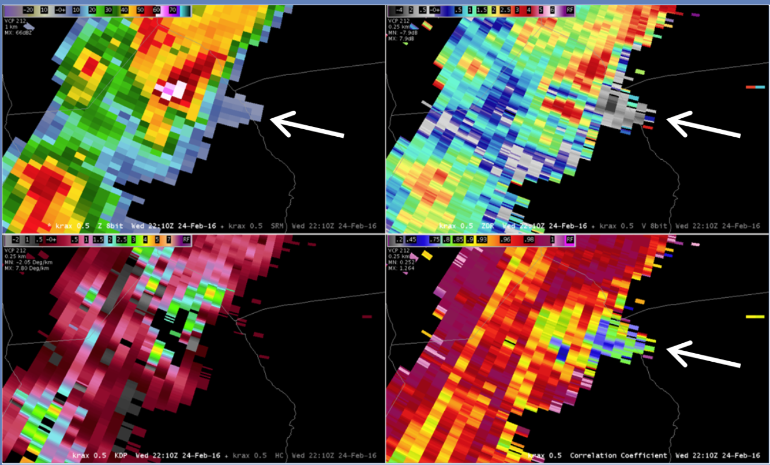
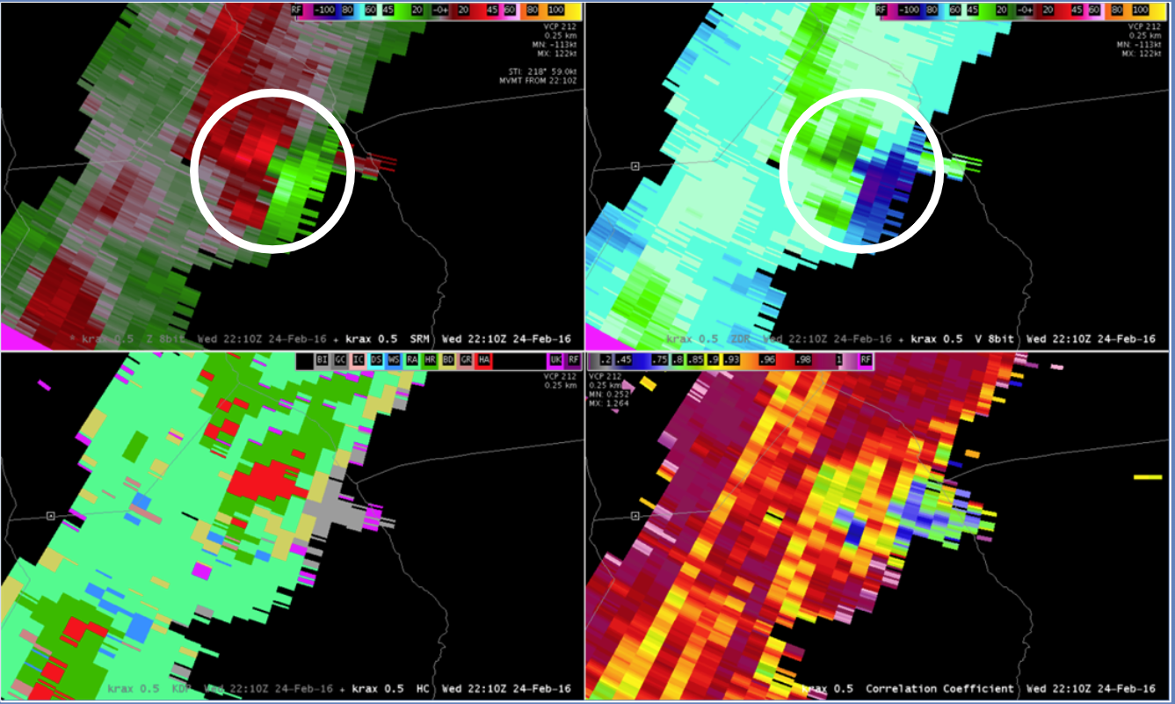
Horizontal Side Lobe Analysis using Dual-Pol

Slide 26
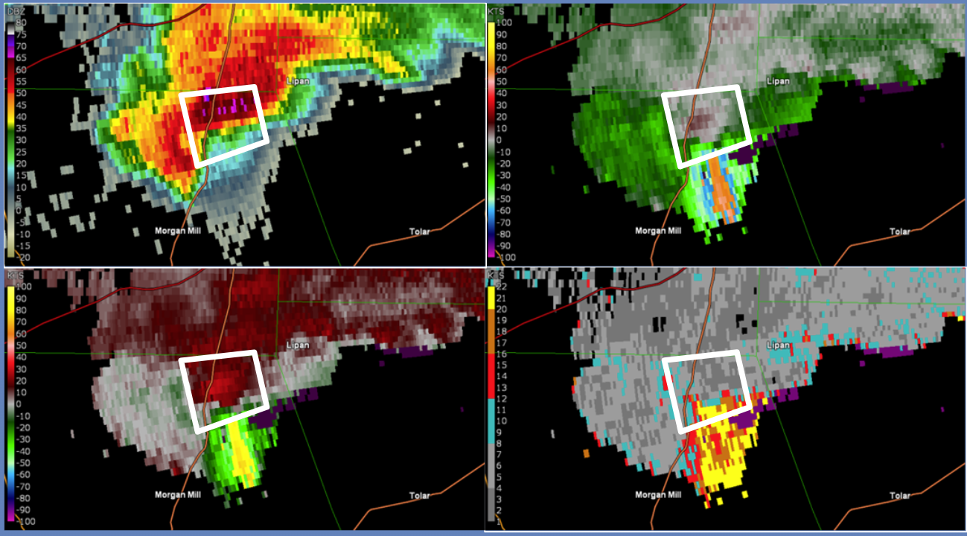
Vertical Side Lobe Analysis using Dual-Pol
0.5 deg

Slide 27
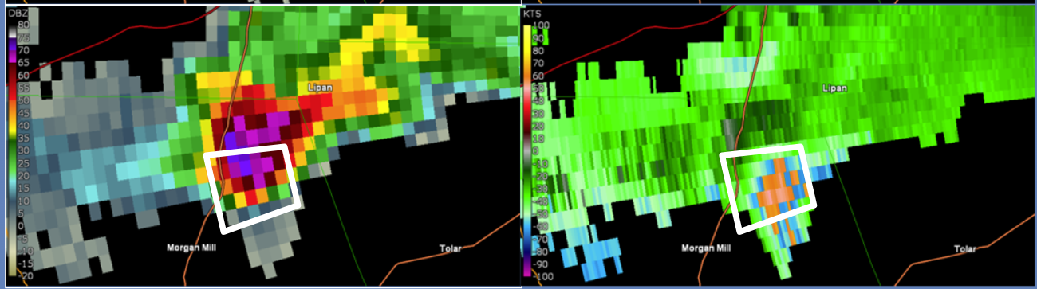
Vertical Side Lobe Analysis using Dual-Pol
0.5 deg
3.4 deg

Slide 28
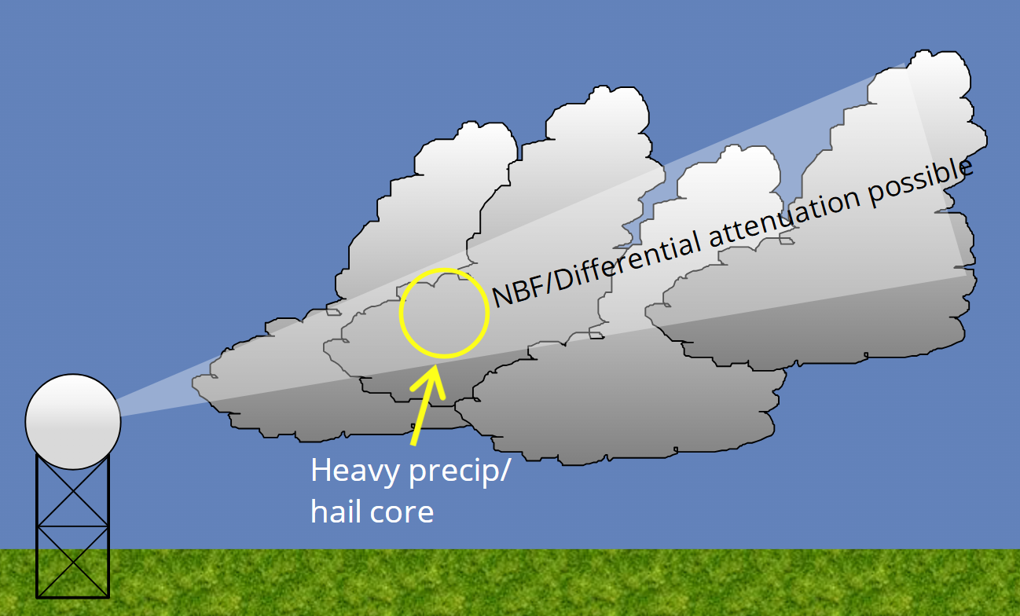
Non-Uniform Beam Filling / Differential Attenuation

Slide 29
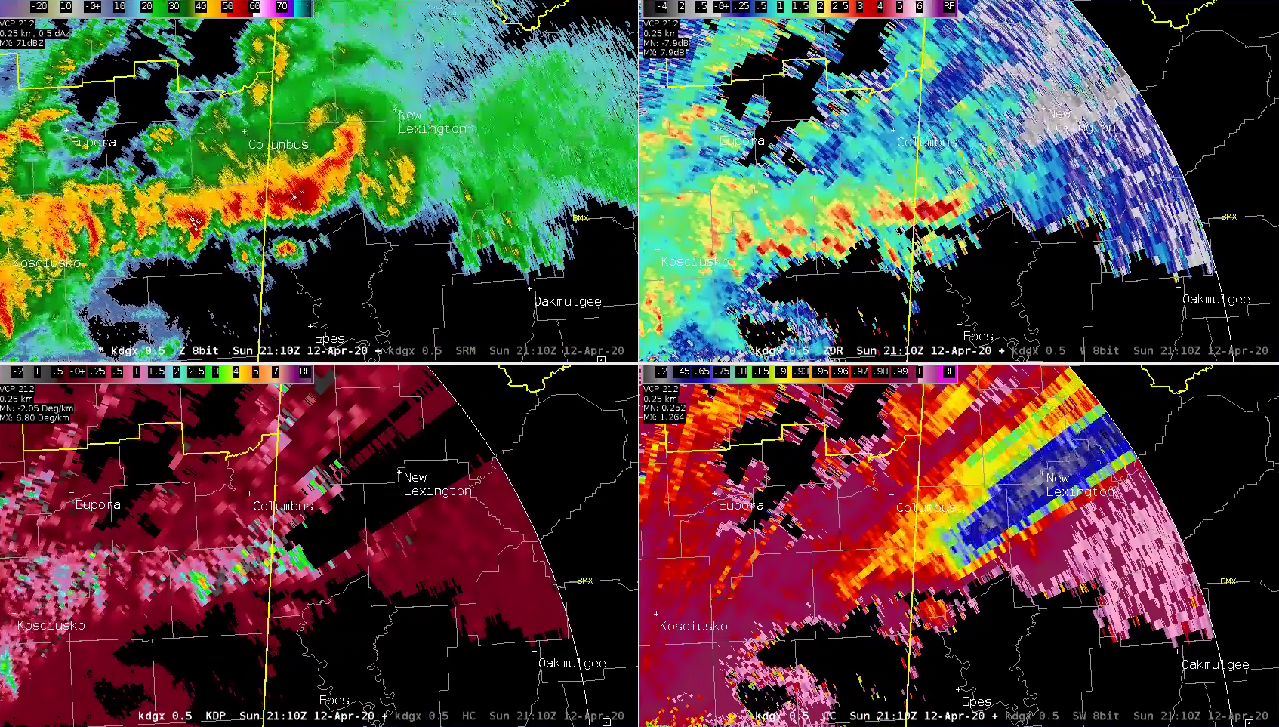
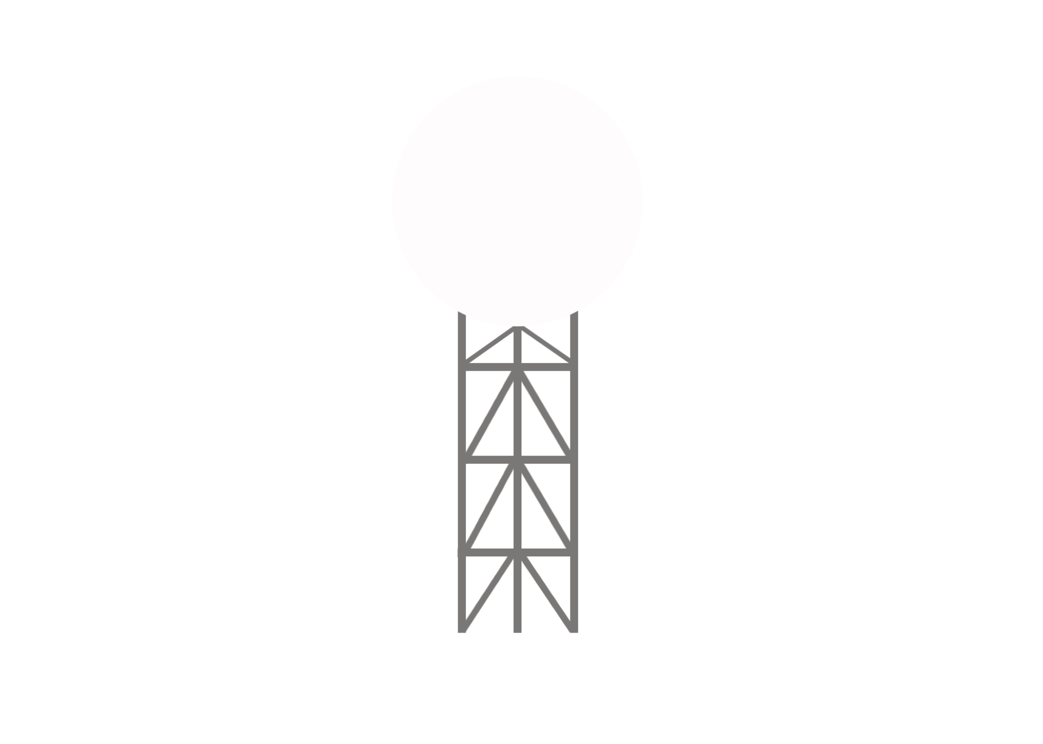
Example of Non-Uniform Beam Filling / Differential Attenuation
RDA Location

Slide 30


Non-Uniform Beam Filling in Dual-Pol Data
NBF results from PhiDP gradient in beam and lowers CC down radial
Notes:
Area to the left has strong NBF while area to the right has some weak NBF signal.

Slide 31

Differential Attenuation in Dual-Pol Data
Differential attenuation results from attenuation differences between horizontal and vertical channels affecting ZDR
Notes:
ZDR shows the opposite signal as previous slide. Differential attenuation strong in area to the right. A milder signal is seen in area to the left.
Different physical processes cause the phenomenon even though they often occur in the same places.

Slide 32
Data Quality
We’ve covered non-uniform beam filling and differential attenuation
Many data quality artifacts also seen in reflectivity and velocity data
Some examples are…
Wet Radome Effect
Biological Returns

Slide 33



Wet Radome Effect
Notice what happens when the line passes over the radar
1959Z
2006Z
2008Z

Slide 34



Biological Returns
What could this artifact be from?
1959Z
2006Z
2003Z
Notes:
Bats leaving a cave around sunset

Slide 35


Data Application: Using SRM to assess Rotational Velocity (Vrot)
Research has found a clear link between Vrot and tornado damage ratings (Thompson et al. 2017)
Guidelines for calculating Vrot:
Max inbound & outbound velocity gates should be co-located with the hook
Max inbound & outbound velocity gates should be ~ 1 - 2 nm apart

Slide 36



Poll Everywhere Exercise: Calculating Rotational Velocity
Respond at: https://pollev.com/wdtdrac321

Slide 37


Slide 38

Poll Everywhere Exercise: Calculating Rotational Velocity
Answer:
~ 84 kts!

Slide 39

Data Application: Using DP variables to identify tornadic debris
Lofted debris from tornado -> randomly oriented -> very low CC values!

Slide 40

Poll Everywhere Exercise: Identifying a TDS
Respond at: https://pollev.com/wdtdrac321

Slide 41


Slide 42

Identifying a TDS: Beware of the Inflow!
Beware of low CC from inflow air -> “don’t bite on bugs in the inflow!”
X

Slide 43
Key Takeaways from Day 1
We make a lot of assumptions about what is actually happening that the data doesn’t actually show us
It’s amazing that these systems (and their data) are as good as they are!

Slide 44
End of Day 1

Slide 45
Part 2: Severe Storms Analysis by Radar
Opening scenario: You make the call
Focusing on threat assessment - Hail, Wind, Tornadoes
Scenarios with things to be mindful of to mitigate risk.
Visual and radar comparisons

Slide 46

Part 2: Severe Storm Detection by the WSR-88D
Scenario 1 - 2110 CDT
driving south and there’s a cell in the way of home.
Your task is to tell me how large you think the hail is.
I can handle 1.5” but 2” is going to make dents. We need to get home to be ready for school tomorrow morning and still get a good night rest.
I don’t think breaking my windshield is worth getting home early. I certainly don’t want to be hit by a tornado.

Slide 47


ERA5 Sounding

Slide 48

2110 Dual Pol Hail Size Guidance

Slide 49

2110 CDT

Slide 50
Poll: 2110 CDT
What hail size does do you think is falling?
<1”, 1 to <2”, 2 -2.5”, 2.75” and larger
Do I continue or hold back?

Slide 51

Scenario 1 - 2117 UTC

Slide 52


2117 CDT

Slide 53
Poll: 2117 CDT
What hail size does do you think is falling?
<1”, 1 to <2”, 2 -2.5”, 2.75” and larger
Do I continue or hold back?

Slide 54


2120 CDT Small Hail Starts

